Slide 1

Modelling smart road traffic congestion control system using machine learning techniques
Faisal Akhtar
Shubhangi Goyal

Slide 2
Abstract
Cities require efficient and sustainable traffic system.
Dynamic traffic flow is a significant issue which brings about a block of traffic movement.
In this paper, artificial neural network is used to predict the traffic congestion.

Slide 3
Abstract (cont.)
Proposed Modeling Smart Road Traffic Congestion Control using Artificial Back Propagation Neural Networks (MSR2C-ABPNN) for road traffic increase transparency, availability and efficiency in services offered to the citizens.
The proposed system aims to provide a solution that will increase the comfort level of travelers to make intelligent and better transportation decision.

Slide 4
Proposed ABPNN system model
This paper has proposed a new Modeling Smart Road Traffic Congestion Control using Artificial Back Propagation Neural Networks (MSR2C-ABPNN) for an intelligent traffic system.
The sensory layer contains the input parameters which shall go to the neural network learning that was trained using an algorithm and predict the congestion point.
If the congestion point is found, the vehicles will receive the message in their LCD’s using RFID sensors, and after that google map is used to find the alternate route.

Slide 5
Proposed ABPNN system model (cont.)
Once again find the congestion in that particular point similar in the case if congestion not found, traffic moves further and finds continuous congestion points.
The model predicts the point of congestion with the help of a neural network using the backpropagation algorithm.

Slide 6
Proposed ABPNN system model (cont.)
In proposed MSR2C-ABPNN, system application is further divided into two sub-layers, prediction and performance layer.
In the prediction layer, back propagation is used to detect the occupancy
While the performance layer evaluates the prediction layer performance in terms of RMSE, Accuracy and Miss Rate.
Adverse weather conditions directly affect the road traffic congestion by decreasing the visibility of the road and the condition of the road becomes worse.

Slide 7
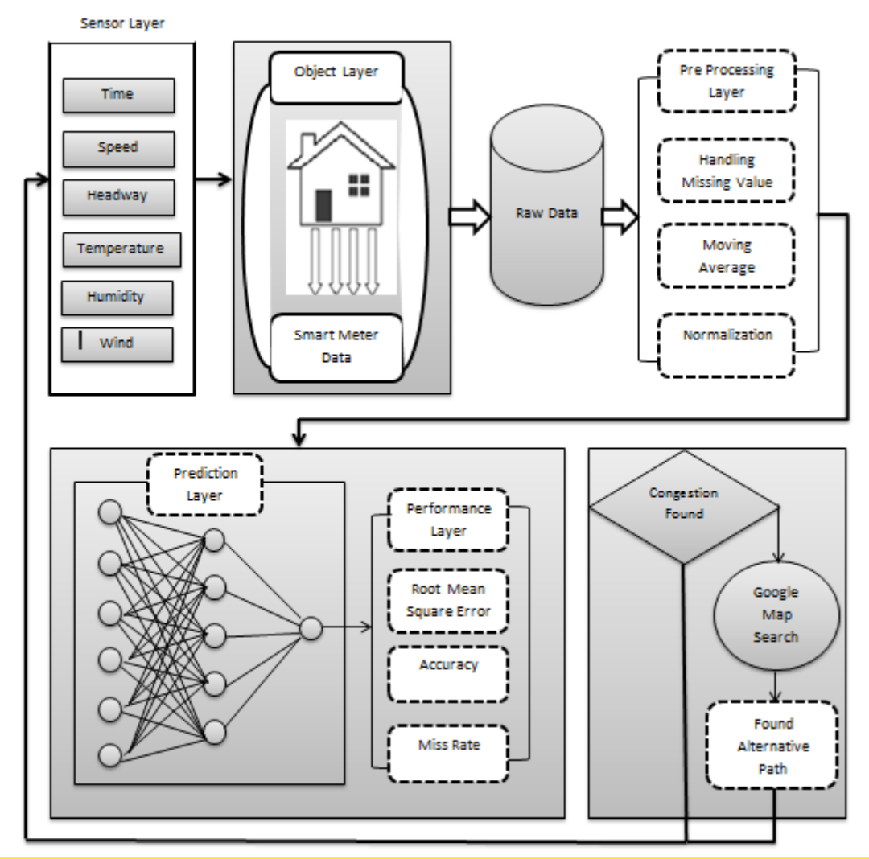

Slide 8
Proposed ABPNN system model (cont.)
The dataset has been adopted from the internet which shows the weather report and traffic speed of M1 junction 37 England at the interval of 10 minutes.
The congestion variables are being defined as an input variable named as shown here
Sr. No | Input/output Variable Name
Input-1 | Time
Input-2 | Traffic Speed
Input-3 | Traffic Flow
Input-4 | Humidity
Input-5 | Wind Speed
Input-6 | Air Temperature
Output-1 | Delay Time

Slide 9
Proposed ABPNN system model (cont.)
The neural network works as a powerful model for solving hard problems.
According to a study, the multilayer perceptron (MLP) were the best model for prediction.
Multilayer perceptron consists of an input and output layer.
The left side layer is known as input layer which receives an input signal and then transmits it into the right side, layer by layer.

Slide 10
Proposed ABPNN system model (cont.)
Back Propagation Algorithm was used to train multilayer perceptron, while the weather information and traffic flows were used to predict congestion.
Furthermore, the data set was used for Traffic flow and weather gathered every 10 minutes a day.
A neural network having an input layer, hidden layer and output layer — the structure composed of the forward propagation and backpropagation of error.

Slide 11
Proposed ABPNN system model (cont.)
In the forward propagation, information is being processed from the input layer to the hidden layer, then finally transmitted to output layer.
If the output layer cannot accept then it sends back to the process of back propagation error, in which different values of weights are adjusted in such a way to minimize error and again transferred to the forward propagation.
Different steps are involved in the algorithm of backpropagation including, Initialization of weight, Feedforward, Back Propagation of error and updating of weight and bias.

Slide 12
Proposed ABPNN system model (cont.)
Every neuron present in the hidden layer has an activation function like f (x) = Sigmoid(x).
The sigmoid function for input is written as
ψ_{j} = b₁+ Σ_{m} ^{i=1} (ω_{ij} × r_{i}), (1)
ϕ_{j} = 1/1+e^{−ψj} where j= 123 . . .n. (2)
Error in backpropagation written as
E = 1/2 Σ_{k} (τ_{k} − ϕ_{k})²

Slide 13
Fitting Modelling
In ANN, fitting network was trained by selecting data and dividing this data into sets as training, validation, and testing to define the architecture of the network.
Performance of the network was measured by regression analysis, to evaluate the results, analyze the tool as a regression fit and mean square error.
If the obtained result was not satisfactory the network re-trains with different dataset.

Slide 14
Time series modelling
ANN time series modelling was trained by selecting data then divide data into sets as training, validation, and testing to define the architecture of the network.
Performance of the network was measured by regression analysis.
To evaluate the results, analyze the tool as an error autocorrelation plot or histogram of the errors.
If the obtained result not satisfied the need then the network retrains with diverse dataset.

Slide 15
Result analysis
Proposed MSR2C-ABPNN |  | Accuracy [ % ] | Miss Rate [ % ] | RMSE [ % ]
Using fitting model | Training | 96.20 | 3.80 | 8.26 x 10⁻²
 | Validation | 95.84 | 4.16 | 9.807 x 10⁻²
Using time series | Training | 98.15 | 1.85 | 1.416 x 10⁻³
 | Validation | 97.56 | 2.43 | 4.351 x 10⁻³

Slide 16
Result analysis (cont.)
It is plausible to state that the proposed MSR2C-ABPNN system has provided better results than the previously mentioned methods regarding MSE as well as Regression value.
It also observed that the proposed MSR2C-ABPNN model with the ANN time Series gives more accurate results as compared to ANN Fitting.

Slide 17
Conclusion
This research has used a neural network as a methodological approach to control the congestion of traffic flow.
It is detected that the smart transportation system has a significant impact on smart city whereas the traditional systems do not have the flexibility to automatically control the adjacent signals timers to minimize the congestion in traffic.
Different sensors implemented on different adjacent signals that collect, share traffic data and sent to a controller through IoT enabled devices.

Slide 18
Conclusion (cont.)
Therefore, if the data received by the signal sensors in delay or too much noise, in that sense proposed (MSR2C-ABPNN) solution performance may be affected.
A neural network has been presented using the fitting and time series model.
Pre-processing is done on the received data from the adjacent signals.
Furthermore, it is observed that the Proposed MSR2C-ABPNN system with an ANN time series gives better results than the ANN time series.

Slide 19
THANK YOU

